Slide 1
Fixed Assets
Notes:
Class starts assuming you are working off of a PR
Class does not cover competition- that is done outside of Pegasys

Slide 2
Fixed Assets
A Fixed Asset is a long-term, tangible object held for business use that is not expected to be converted to cash in the current or upcoming fiscal year.
Examples of Real property fixed assets maintained by GSA PBS are land, buildings, artwork and improvements.
Personal property fixed assets are operating and administrative equipment.
Each stage of a fixed asset’s life cycle is recorded in Pegasys through the creation and processing of forms.

Slide 3
Standard Purchasing Chain
Invoice
M7/M6
Request
PR
Order
GP
QP,FP,TP
OP
XP
PJ, PN, PP
Payment
Authorization
P7/P6
Receipt
RW/RK
Funds
FTS is moving to Region 6
FTS or PBS
RW and M7
All Others
RK and M6
Notes:
We are copying forward from PR to GP- we just fill in the missing information

Slide 4
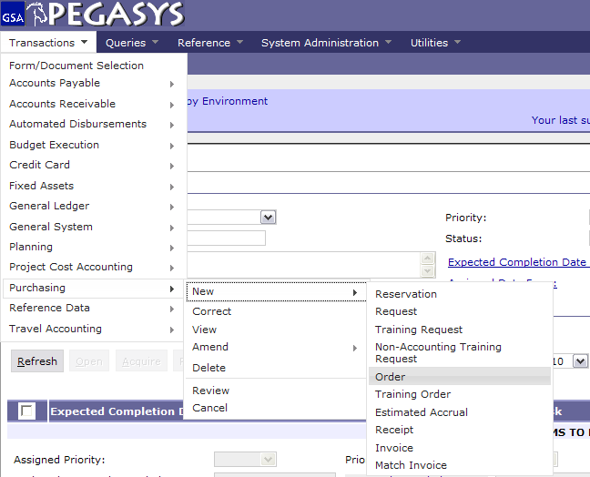
Creating a Purchase Order
- Transaction
- Purchasing
- New
- Order

Slide 5
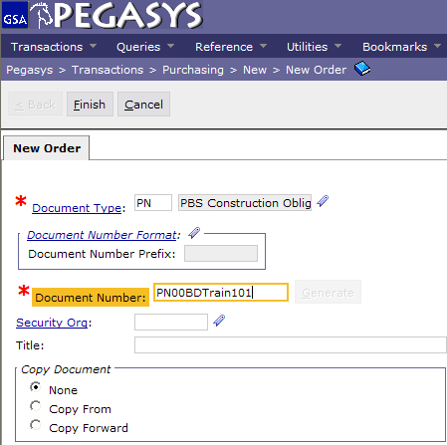
Creating a Purchase Order
- Enter Document Type (PN)
- Press Tab
- Enter Document Number
- Click Finish

Slide 6
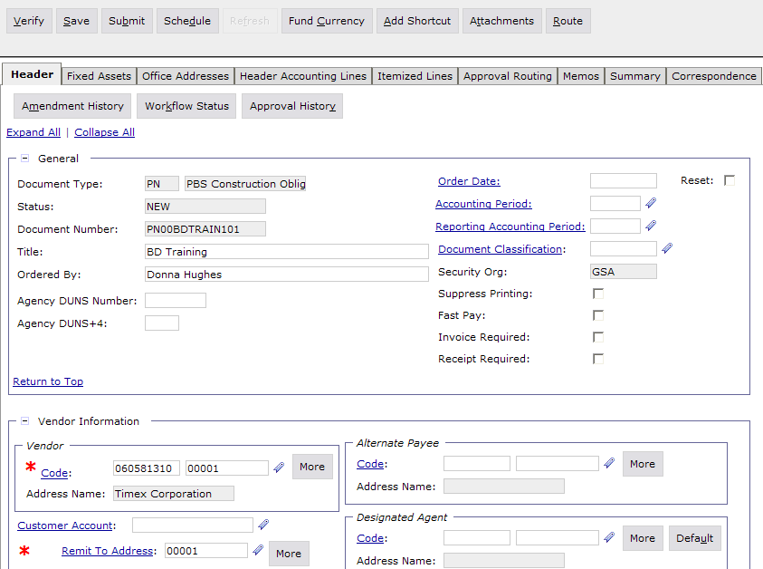
One Header Accounting Line to One Asset Record
Enter Title
Enter Order By
Enter Vendor Information
Click Header Accounting Lines

Slide 7
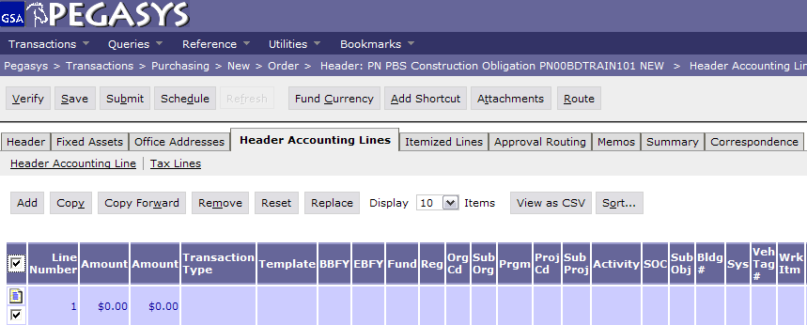
One Header Accounting Line to One Asset Record
Once at the Header Accounting Lines tab, click the Add button.

Slide 8
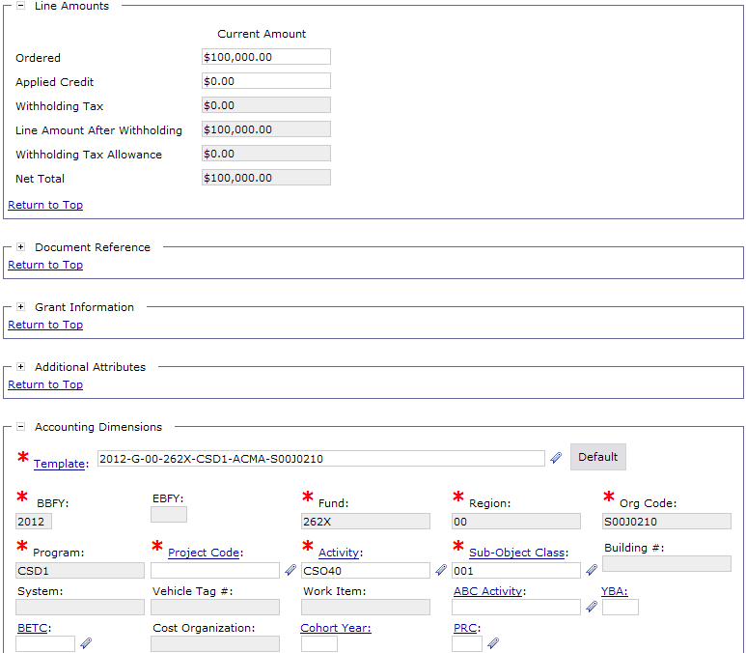
One Header Accounting Line to One Asset Record
Enter Line Amount
Enter Accounting Template
- Click Fixed Assets Tab

Slide 9
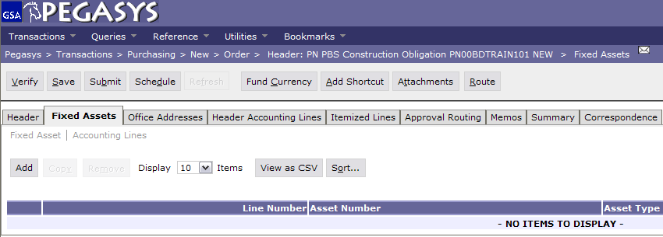
One Header Accounting Line to One Asset Record
Once at the fixed assets tab, click the Add button.

Slide 10
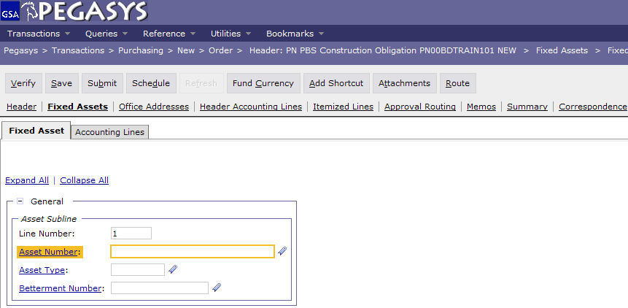
One Header Accounting Line to One Asset Record
Click the Asset Number link to search for an Asset Number.

Slide 11
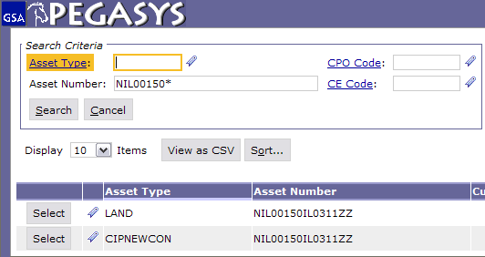
One Header Accounting Line to One Asset Record
The Search Asset Query page appears.
Since Real Property Asset Numbers begin with the Project Code, the project code will be entered followed by an asterisk.
Click Search.
Click Select to choose the Asset Number.

Slide 12
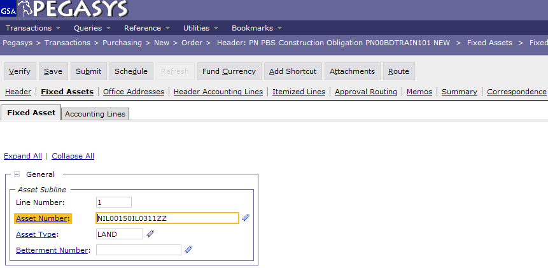
One Header Accounting Line to One Asset Record
Asset Number and type auto populate.
Enter Betterment Number, it is 0 for the original asset.
Click on the Accounting Lines Tab.

Slide 13
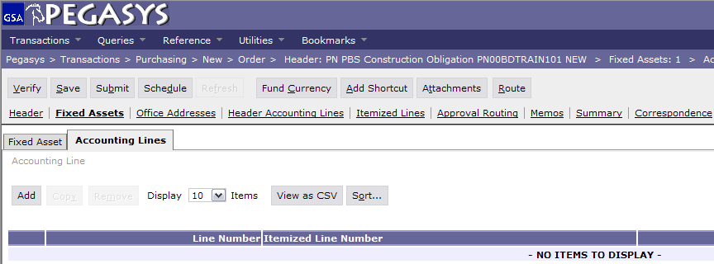
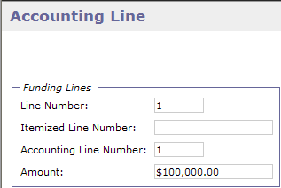
One Header Accounting Line to One Asset Record
Click Add.
The Accounting Line Number should reference a Header Accounting Line on this order, enter 1 in the field.
The Header Accounting Line has $100,000 on it, put the entire amount on this Asset.
Click Save, Verify Submit.

Slide 14
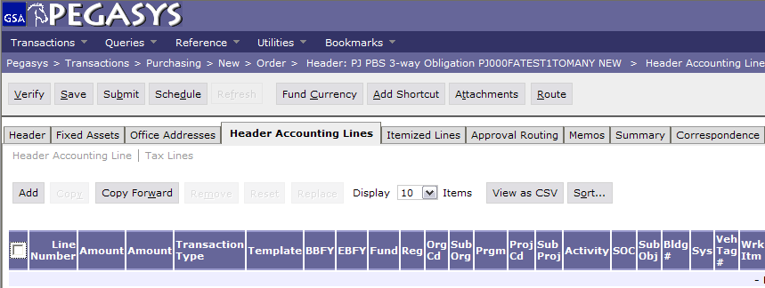
One Header Accounting Line to Multiple Asset Records
Create a new Order
On the Header Tab click on Header Accounting Lines
On Header Accounting Lines click Add

Slide 15
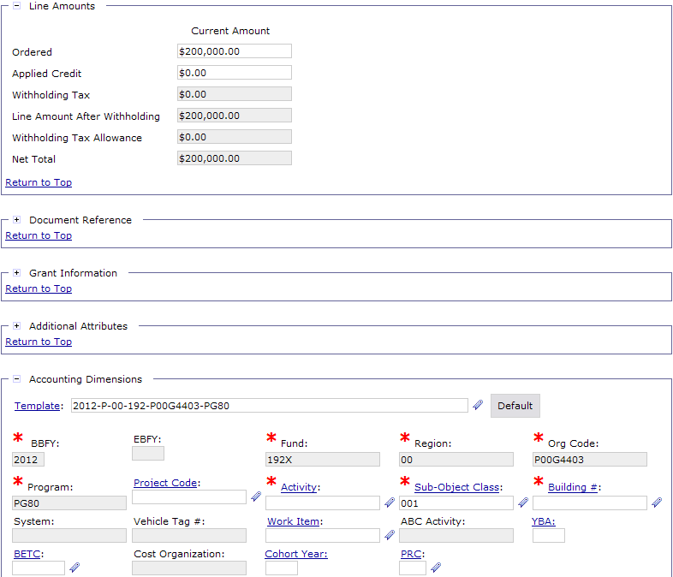
One Header Accounting Line to Multiple Asset Records
Enter the Accounting Dimensions information
There will be one $200,000 Header Accounting Line on this order.
The above amount will be split into 2 Assets
When done click the Fixed Assets Tab

Slide 16
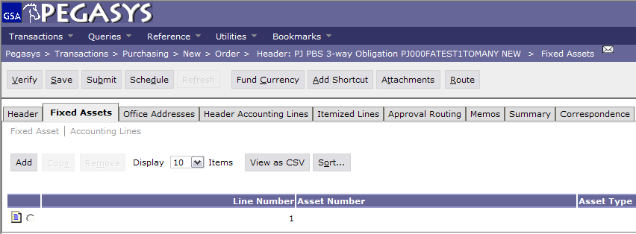
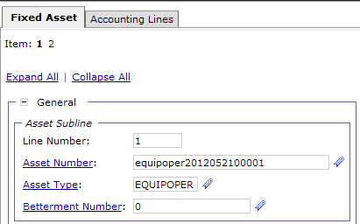
One Header Accounting Line to Multiple Asset Records
Click Add
Enter: the first Asset Number, Asset Type and 0 as the Betterment Number
Click Accounting Lines

Slide 17
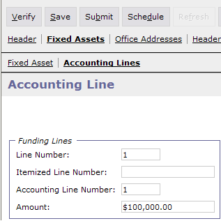
One Header Accounting Line to Multiple Asset Records
Once in the Asset Accounting Line page, click add.
Enter 1 in the Accounting Line Number field
Enter $100,000 in the amount field (splitting up into 2 assets)
Click the Fixed Assets Tab to add another asset line

Slide 18
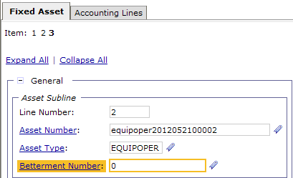
One Header Accounting Line to Multiple Asset Records
Click Add
Enter: the second Asset Number, Asset Type and 0 as the Betterment Number
Click Accounting Lines
Once in the Asset Accounting Line page, click add.
Enter 1 in the Accounting Line Number field
Enter $100,000 in the amount field (splitting up into 2 assets)
Click Save, Verify, Submit

Slide 19
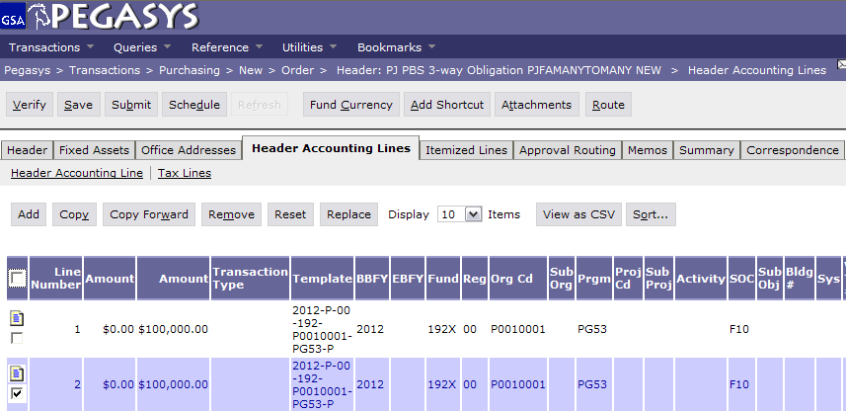
Multiple Header Accounting Lines to Multiple Asset Records
Create a new order and go to the Header Accounting Lines Tab and create multiple lines, in this case there are 2. Then click on Fixed Assets Tab.

Slide 20
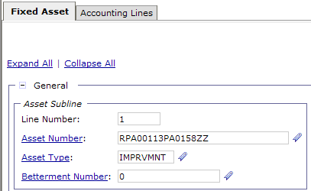
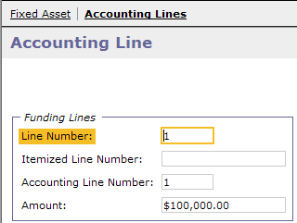
Multiple Header Accounting Lines to Multiple Asset Records
Click the Add button.
On the 1st fixed asset line, we’ll reference asset RPA00113PA0158ZZ.
Asset type is improvmnt.
Betterment is 0.
Click Accounting Lines and then add.
Fill in the line number and amount.
Click Fixed Assets Tab and Add another line.

Slide 21
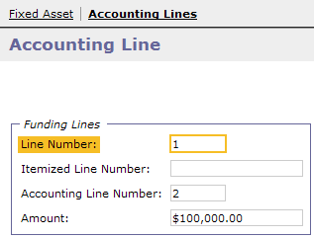
Multiple Header Accounting Lines to Multiple Asset Records
Click the Add button.
On the 1st fixed asset line, we’ll reference asset RPA00113PA0158ZZ.
Asset type is improvmnt.
Betterment is 0.
Click Accounting Lines and then add.
Fill in the line number and amount.
Click Fixed Assets Tab.

Slide 22
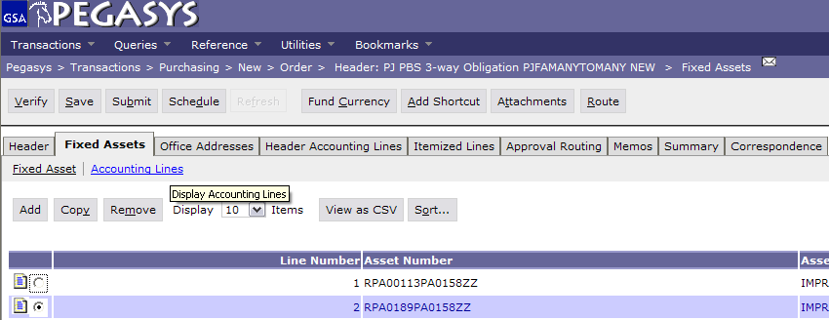
Multiple Header Accounting Lines to Multiple Asset Records
Once on the Fixed Assets page, click save, verify, submit

Slide 23
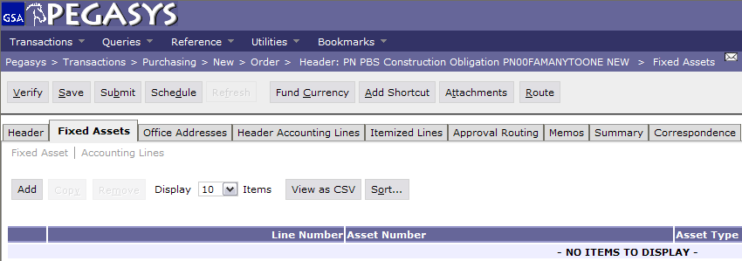
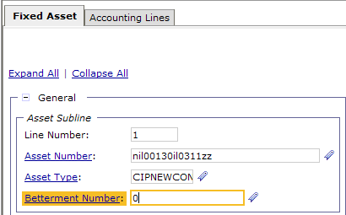
Multiple Header Accounting Lines to One Asset Record
Create a new order.
Click the Fixed Asset Tab to reference an asset.
Click Add.
Enter the Asset Number that will have 2 Asset Accounting Lines. Then fill in the remaining fields.
Click Accounting Lines.

Slide 24
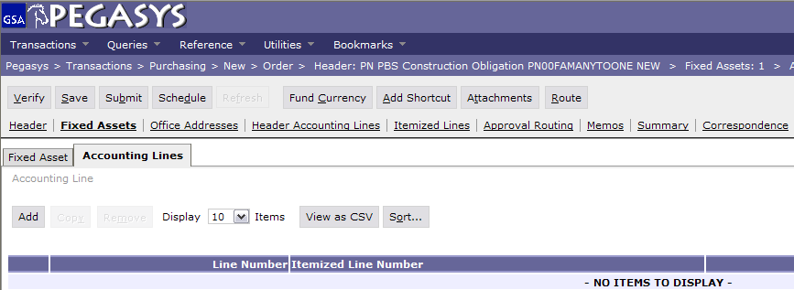
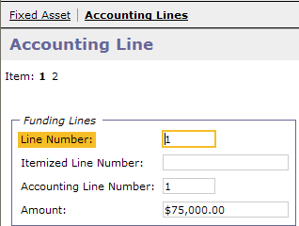
Multiple Header Accounting Lines to One Asset Record
Click Add.
Enter the 1st Header Accounting Line Amount.
Click Accounting Lines, when the page appears click the Add button.

Slide 25
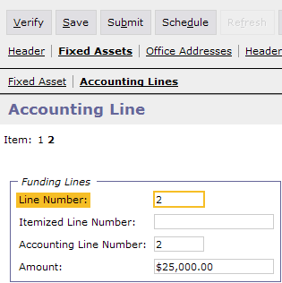
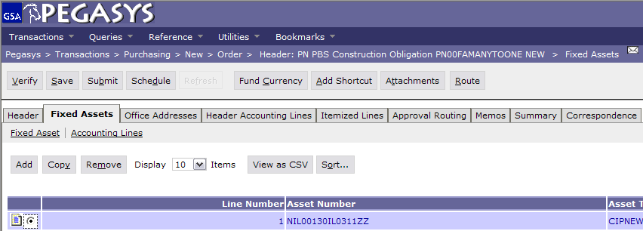
Multiple Header Accounting Lines to One Asset Record
Enter the 2nd Header Accounting Line Amount.
Click the Fixed Asset Tab.
There now is a fixed asset with 2 Asset Accounting Lines matching 2 Header Accounting Lines amounts.
Click the Header Tab

Slide 26
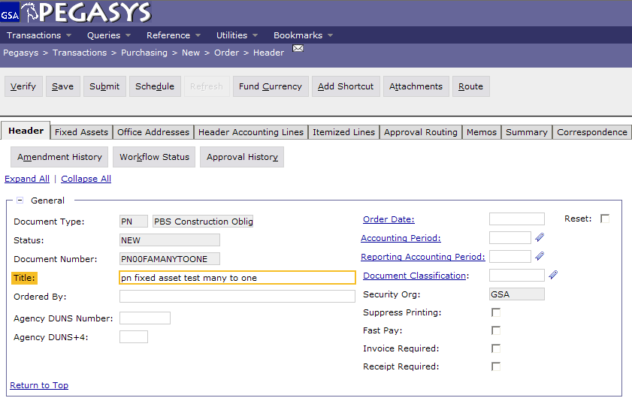
Multiple Header Accounting Lines to One Asset Record
Click Save, Verify, Submit

Slide 27
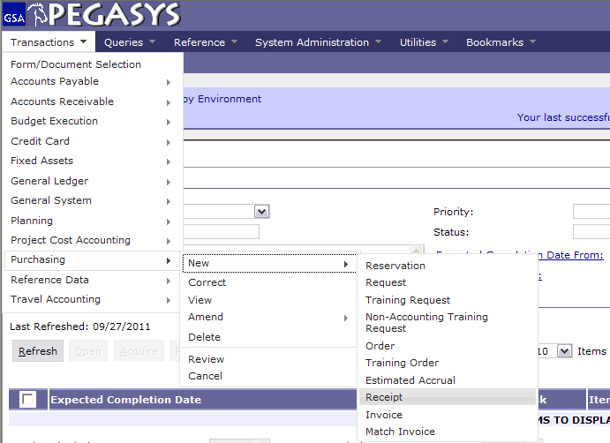
Creating a Receipt
Select:
-Transactions
-Purchasing
-New
-Receipt

Slide 28
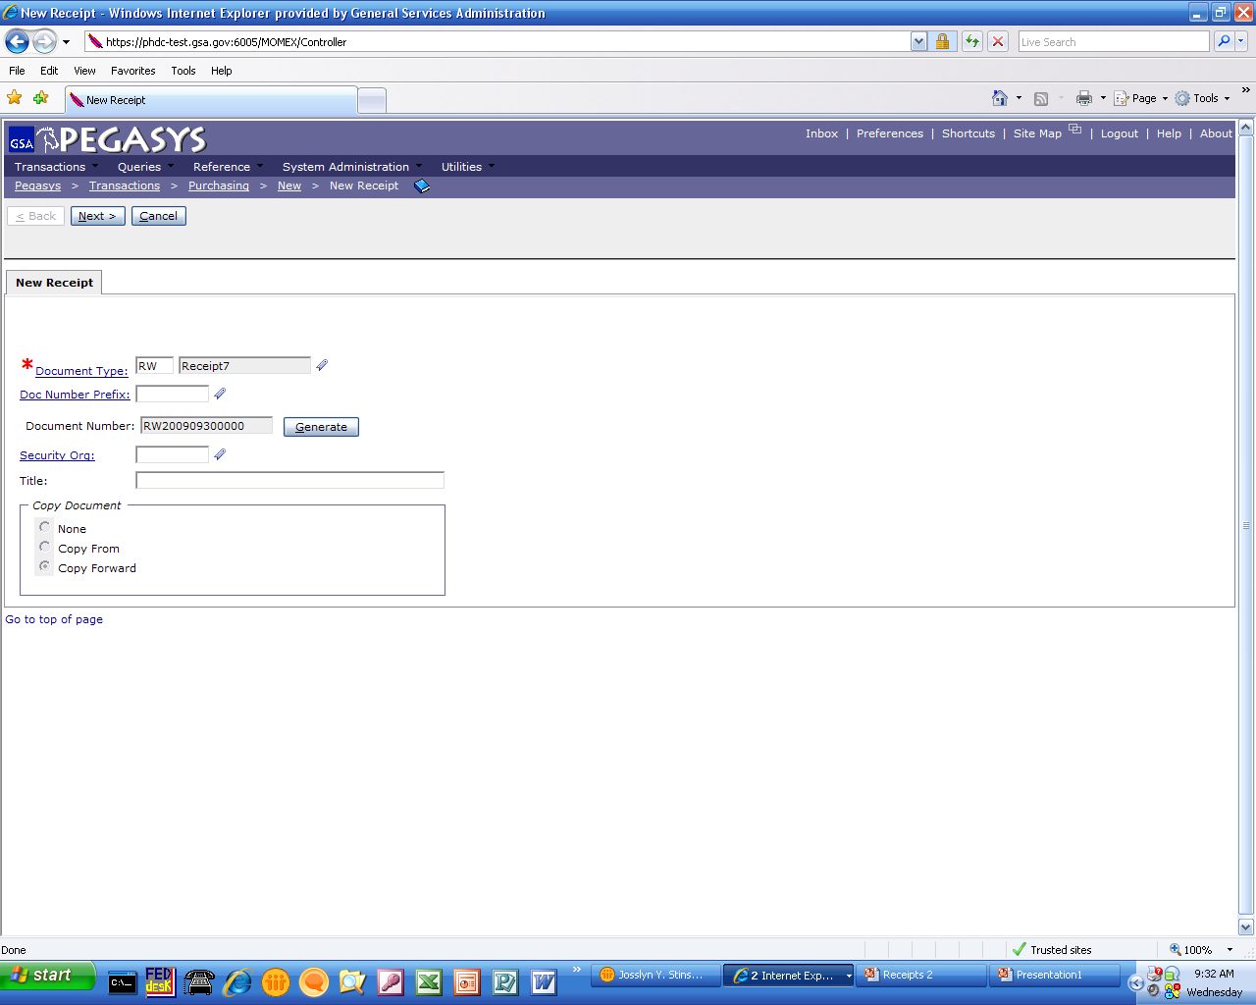
Creating a Receipt
Doc Types
RK – Kansas City
RW – Fort Worth
- Enter Document Type
- Press Tab
- Click Generate
- Click Next
Copy Forward
Auto default for RKs and RWs
Copies information from the
previous document in the chain

Slide 29
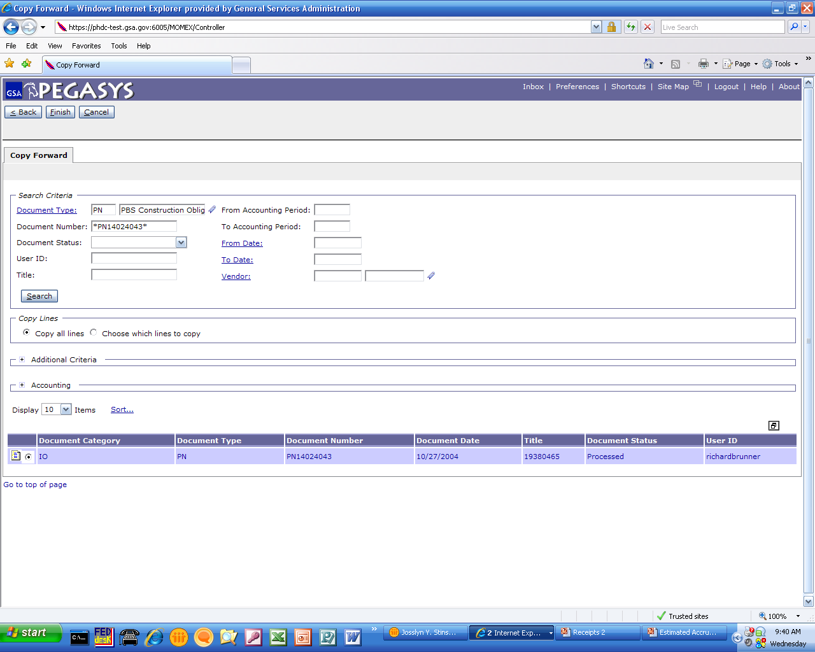
Creating Receipt – Copy Forward
- Enter Document Number
- Press Tab
- Click Search
- Highlight Radio Button
- Click Finish
Purchase Orders
GP = GM&A
FP, TP, QP = FAS
XP = Clients
PJ, PN, PP = PBS

Slide 30
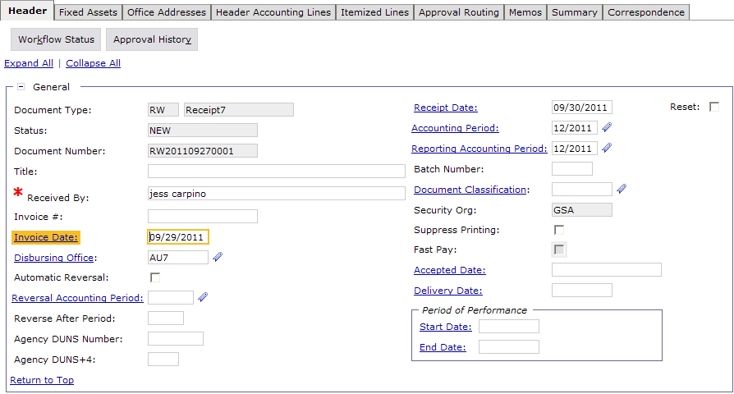
Creating Receipt – Copy Forward
Enter:
-Received By
-Invoice #
-Invoice Date
-Accepted Date
-Delivery Date
Dollar amount does not change

Slide 31
Creating Receipt – Copy Forward
- Enter Document Number
- Press Tab
- Click Search
- Highlight Radio Button
- Click Finish
Purchase Orders
GP = GM&A
FP, TP, QP = FAS
XP = Clients
PJ, PN, PP = PBS

Slide 32
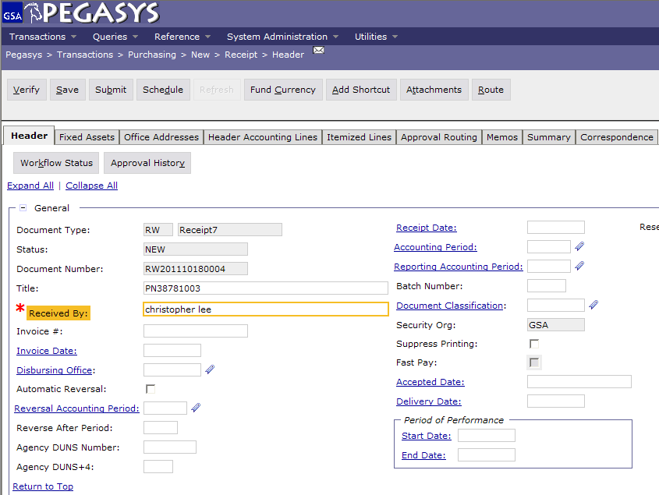
Creating Receipt – Copy Forward
Enter Received by field
Click Fixed Asset Tab

Slide 33
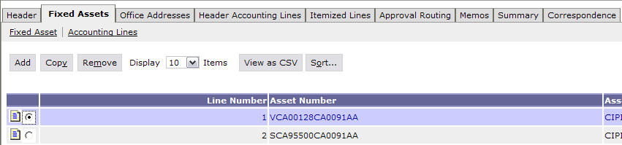
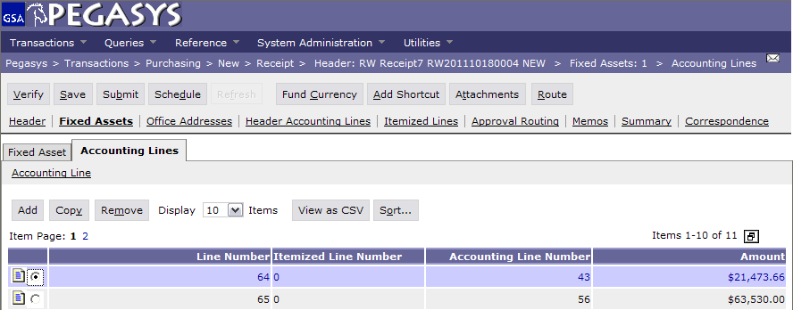
Creating Receipt – Fixed Assets Tab
Select the Fixed Assets
- Click Accounting Lines
Then
Select the Line Number with desired amount
- Click Accounting Lines

Slide 34
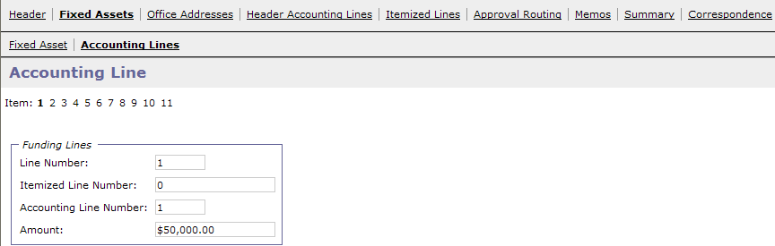
Creating Receipt – Fixed Assets Tab
- Enter Amount ($50,000)
- Click Header Accounting Lines

Slide 35
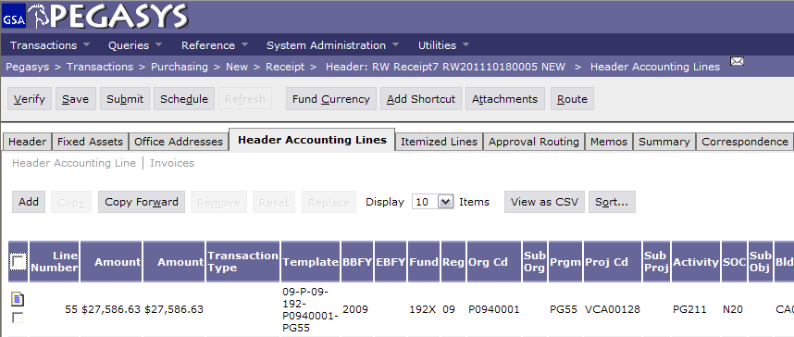
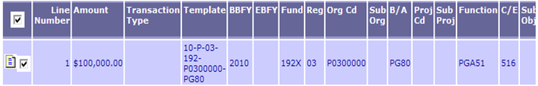
Creating Receipt – Header Accounting Line
Select Accounting Line
Click Header Accounting Lines

Slide 36
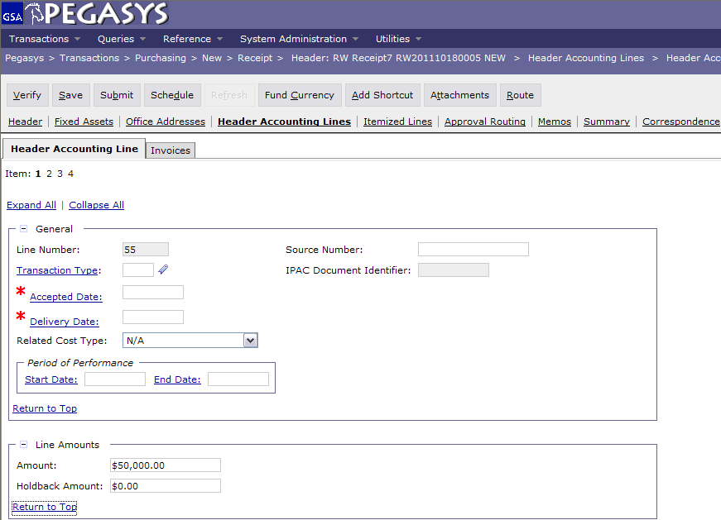
Creating Receipt – Header Accounting Line
Enter the amount in the field.
Click Save, Verify, Submit

Slide 37
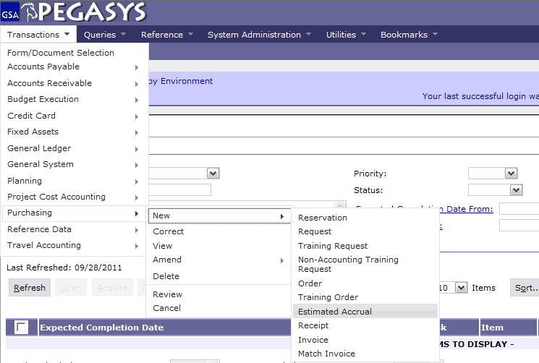
Creating an Estimated Accrual (AE)
- Transaction
- New
- Purchasing
- Estimated Accrual

Slide 38
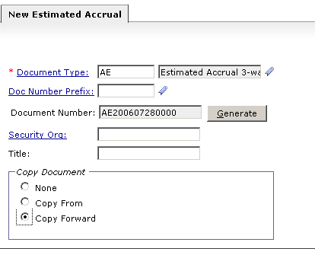
Creating an Estimated Accrual – (AE)
- Enter Doc Type
- Click Tab
- Click Generate

Slide 39
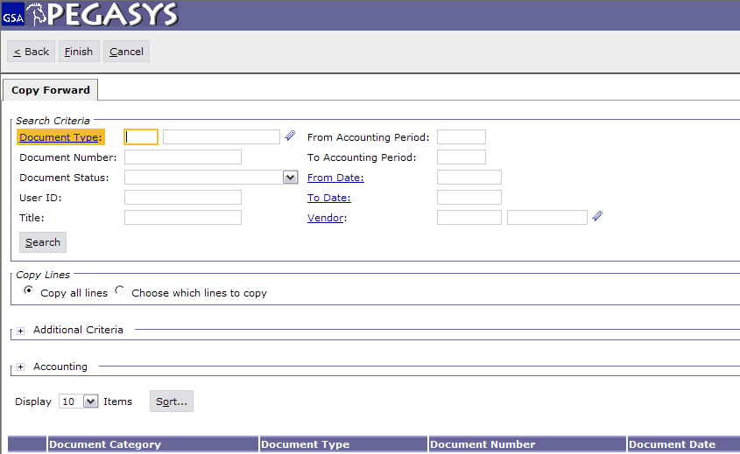
Creating an Estimated Accrual (AE) - Copy Forward
Enter Doc Number
Click Search
Highlight Results
Click Finish

Slide 40
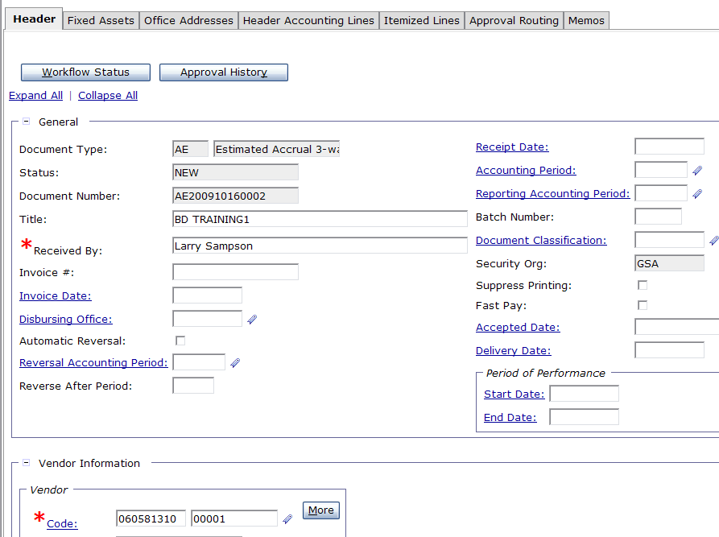
Creating an Estimated Accrual (AE) – Header Tab
All required fields should populate, if not, you must fill in the proper fields
- Click Header Accounting Lines Tab

Slide 41
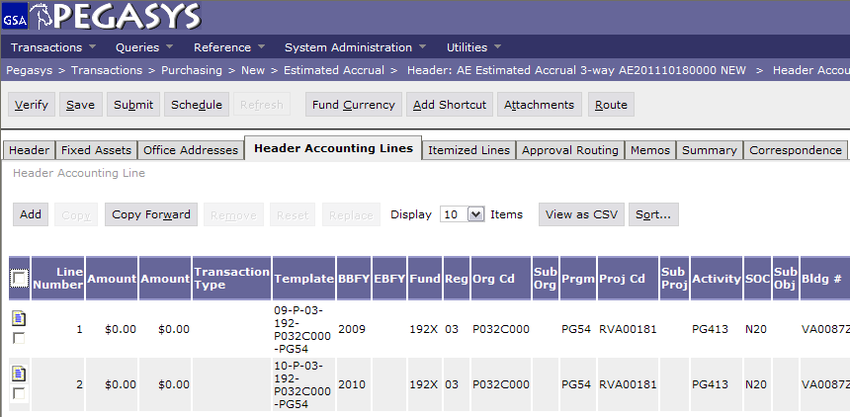
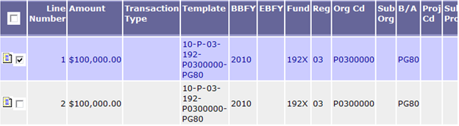
Creating an Estimated Accrual (AE) – Header Accounting Lines
Select Accounting Line
Click Header Accounting Lines

Slide 42
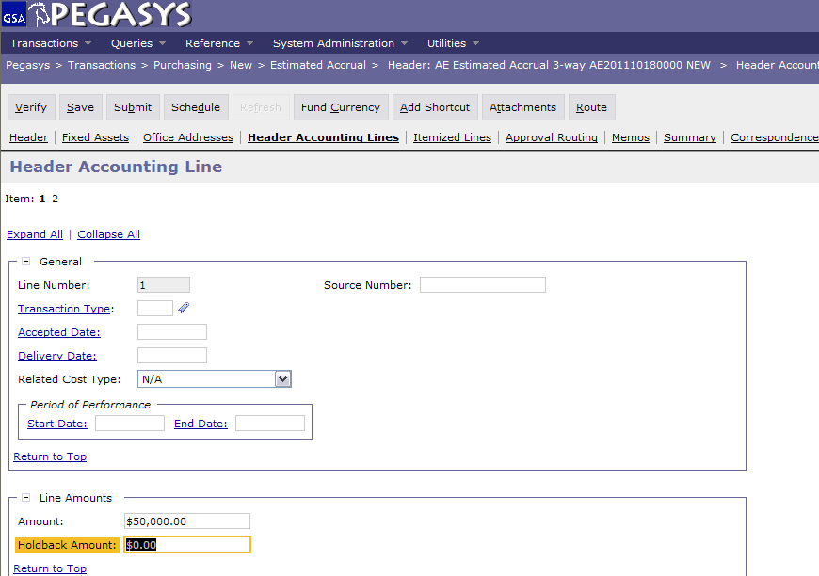
Creating an Estimated Accrual (AE) – Change Line Amount
- Enter Amount ($50,000)
- Click 2
Change $100,000 Line Amount to $50,0000

Slide 43

Creating an Estimated Accrual (AE) – Change Line Amount
- Enter Amount ($50,000)
- Click Fixed Assets
Again, change $100,000 Line Amount to $50,0000

Slide 44
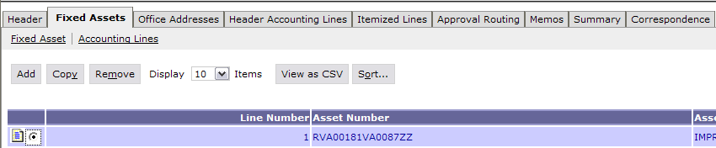
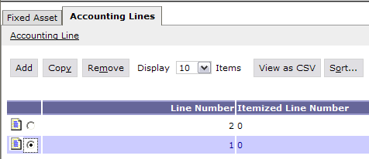
Creating an Estimated Accrual (AE) – Accounting Lines
Select Fixed Asset
- Click Accounting Lines
Select first Accounting Line
- Click Accounting Lines

Slide 45
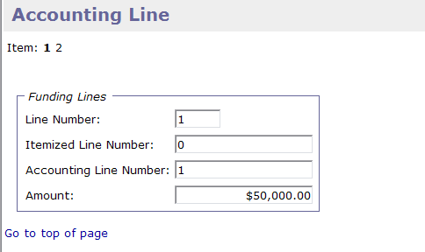

Creating an Estimated Accrual (AE) – Accounting Lines
Change Amount on both Accounting Lines
Change Amount to $50,000
- Click Item 2
- Click Save, Verify, Submit

Slide 46

Fixed Asset Query
Select:
-Queries
-Fixed Assets
-Asset Query

Slide 47

Fixed Asset Query
Use * as a wild card for searching
- Enter Asset Number (NIL0015*)
- Click Search
- Select desired Asset Type
- Click Details

Slide 48

Asset Query Details
This page provides information specific to the original asset and its betterments
- Click Details

Slide 49


Asset Detail
Select Asset Line
Click Asset Detail
Shows all amounts related to the Asset

Slide 50


Accounting Detail

Slide 51


Spending Details

Slide 52

Asset Depreciation History

Slide 53

Asset Fiscal Year Depreciation

Slide 54

Goals of Information Security
Confidentiality
  Data must be protected against unauthorized disclosure
Integrity
  Systems must not permit processes or data to be changed without authorization
Availability
  Systems must be functional and operational
Confidentiality
Integrity
Availability

Slide 55
Why is Information Security Important?
Must be in compliance with regulatory requirements such as OMB Circular A-130, Computer Security Act, FISMA and GSA IT security policies
Protects GSA information resources from potential abuse and misuse
Follows sounds business practices

Slide 56
User Responsibility
Responsible for adherence to GSA information security policy
Protect Pegasys login ID and password
  Do not allow others to use your login ID / password
  Do not write it down
Log out whenever you are not using Pegasys
Protect sensitive information
  Shred reports containing sensitive information
Report security incidents
  Refer to OCFO Incident Handling Procedures for further guidance
  Report security incidents to your supervisor

Slide 57

Keys to Incident Prevention
Awareness - be aware of the value of the assets you are using to do your job and the nature of associated threats vulnerabilities and suspicious activities
Compliance - comply with established safeguards, policies, and processes
Common Sense - if something appears to be off, it generally is

Slide 58

Remember ...
Security is a PEOPLE issue,
not only a TECHNICAL one!

